Slide 1

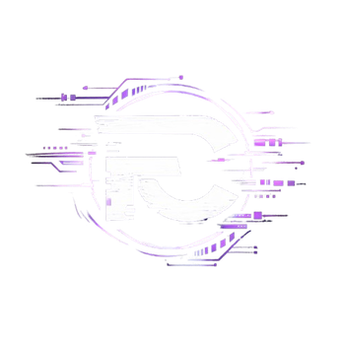

FANTOMCODE 2026
24-Hour National Level Hackathon
Team Name: Deep Thinkers
Team Members:
Kapil G Ratan
Tinku Jana

Slide 2
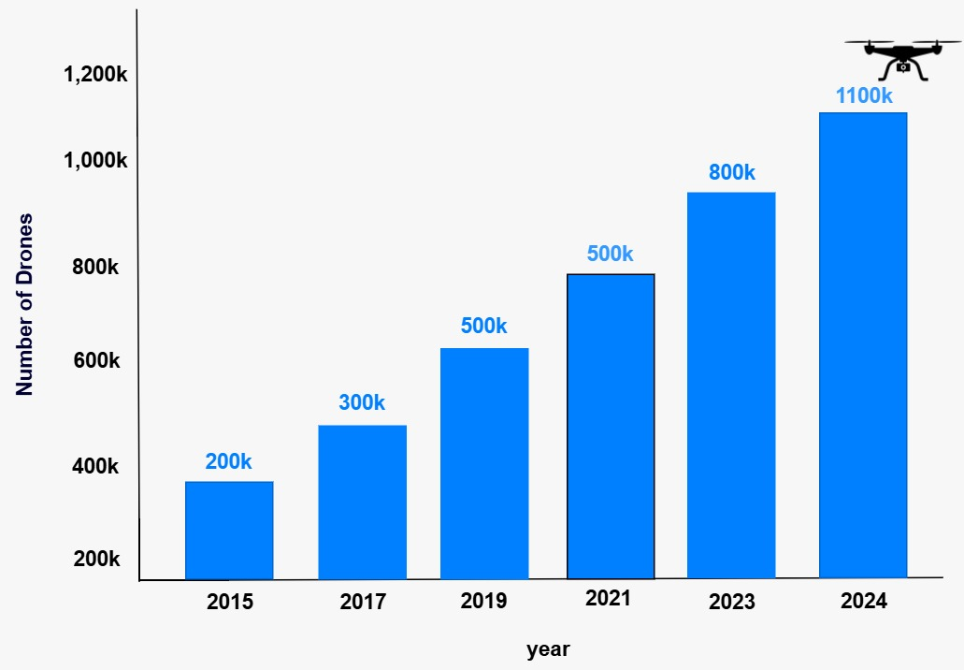
PROBLEM STATEMENT
Problem Statement: “Design and develop a Robust Drone Detection System that accurately differentiates drones from birds in radar systems”
Rapid growth in drone usage has increased airspace complexity and management challenges.
Drone misuse for surveillance and illegal activities poses serious security threats.
Radar systems struggle to distinguish drones from birds, making accurate classification difficult.
Accurate Drone classification is a major challenge in Radar Systems
Fig 1: Increased Drones
2

Slide 3
PROJECT TITLE
Intelligent Drone Detection System Using Micro-Doppler Signatures
Proposed System
We propose an AI-based drone detection system that uses micro-Doppler signatures from radar signals to accurately distinguish between drones and birds.
The system converts radar signals into spectrogram images and applies deep learning models for intelligent classification.
Working Steps
FMCW radar captures signals.
Micro-Doppler Extracts motion-based patterns.
Signal Processing to time-frequency spectrograms.
AI-Based Classification CNN model Classifies object as Drone or a Bird.
3

Slide 4
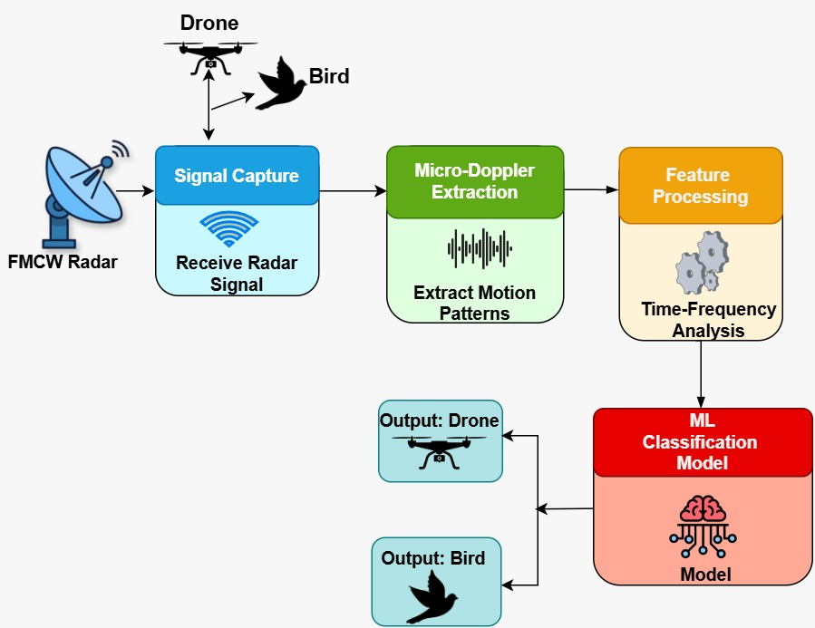
System Architecture
Technology Stack
Python Programming
Google Colab
KTM Radar Measurement Dataset
GitHub
Libraries: NumPy, SciPy, Pandas, Librosa, OpenCV, TensorFlow, PyTorch, Matplotlib, Seaborn, Streamlit
Fig 2: System Architecture Flow
4

Slide 5
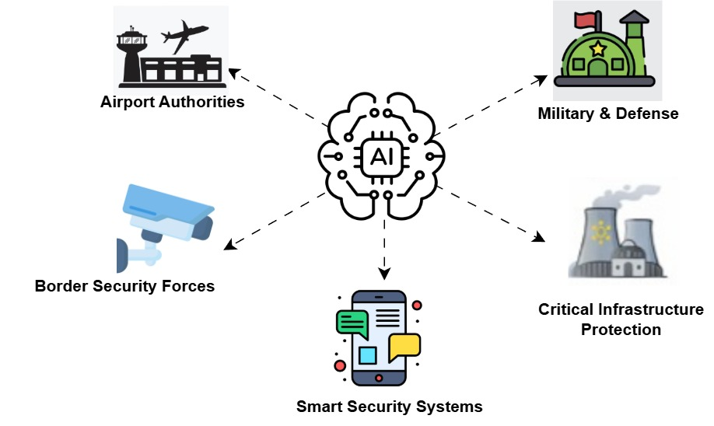
System Applications
Fig 3: System Stake Holders
5

Slide 6
Dataset Description
Contains radar signals of birds, humans, and six different types of drone.
The data designed for classification tasks, between biological entities and various unmanned aerial vehicles.
The collection comprises a total of 75,868 samples, available for research and model development.
Source: KTH Drone Dataset https://zenodo.org/records/5845259?utm_source=chatgpt.com
Data Preprocessing
Drones: 58768 | Birds: 7792 => Biase
Used Under Sampling Technique
Total used samples : 15584
5

Slide 7
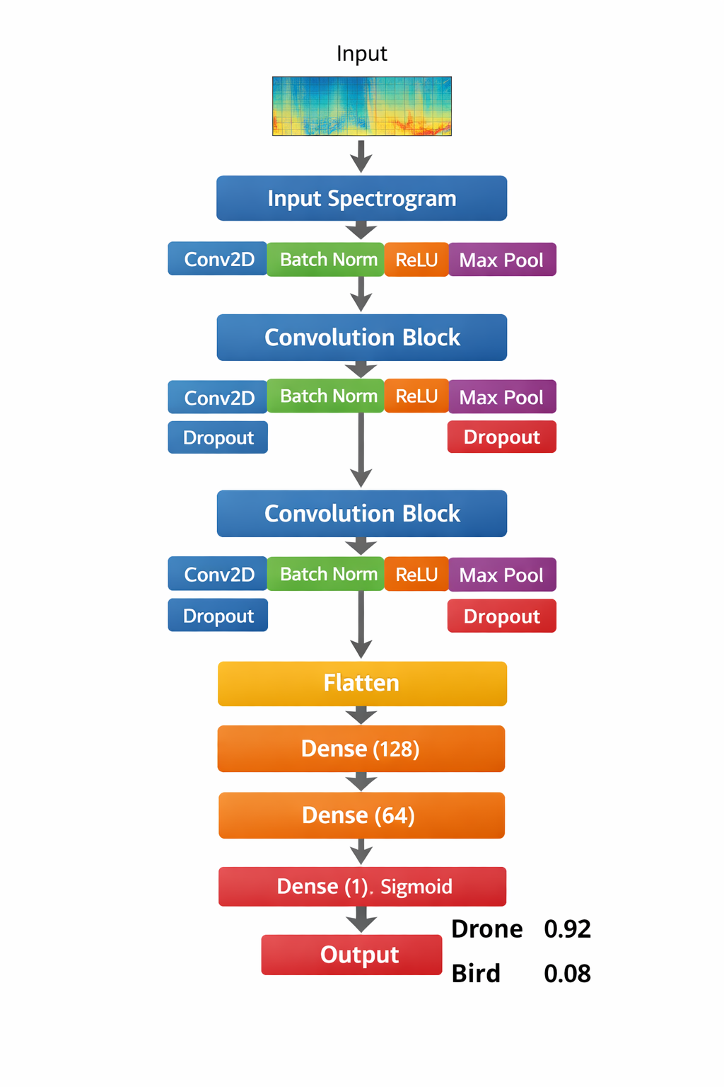
Model Architecture
Convolution Blocks extract important spatial and frequency features from spectrogram images.
Batch Normalization stabilizes and speeds up training by normalizing layer outputs.
Dropout Layers reduce overfitting and improve model generalization.
Sigmoid Layer outputs probability to classify input as Drone or Bird.
5

Slide 8
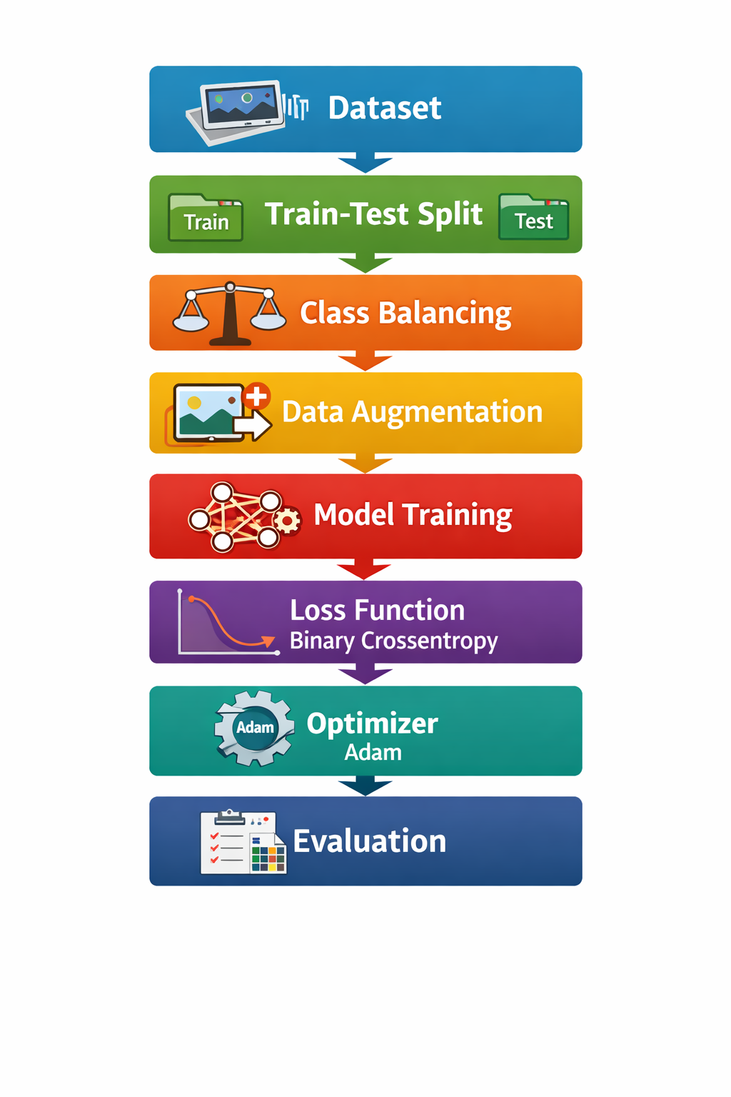
Training Pipeline
Contains radar signals of birds, humans, and six different types of drone.
The data designed for classification tasks, between biological entities and various unmanned aerial vehicles.
The collection comprises a total of 75,868 samples, available for research and model development.
Total: 15584 | Train: 10908 | Val: 2338 | Test: 2338
5

Slide 9
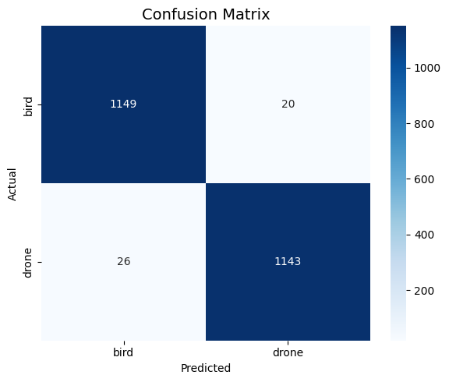
Training Results
Benchmark Matrices
Accuracy : 0.9803
AUC : 0.9970
Precision : 0.9828
Recall : 0.9778
Fig 6: Confusion matrix
5

Slide 10
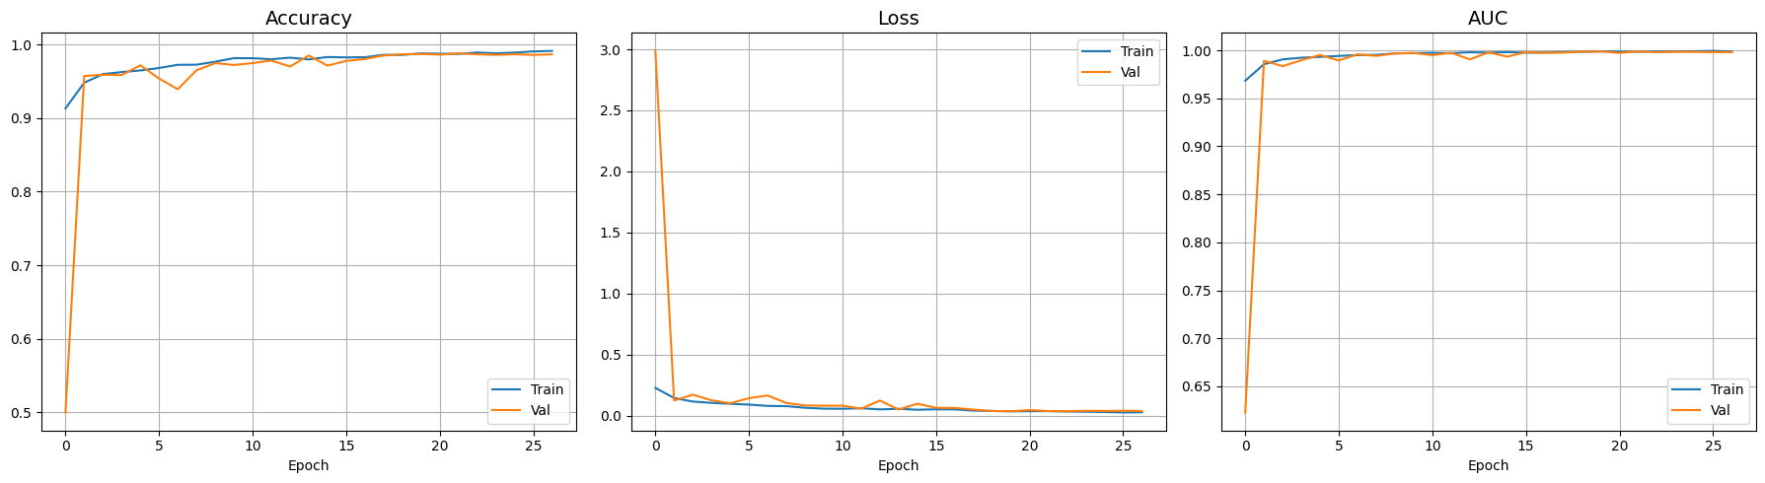
Training Results
Fig 7: Graphs
5

Slide 11
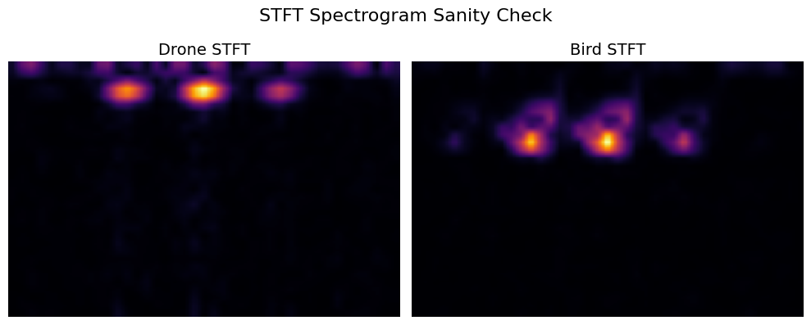
Spectrogram Image
Fig 8: STFT Spectrogram Image
5

Slide 12
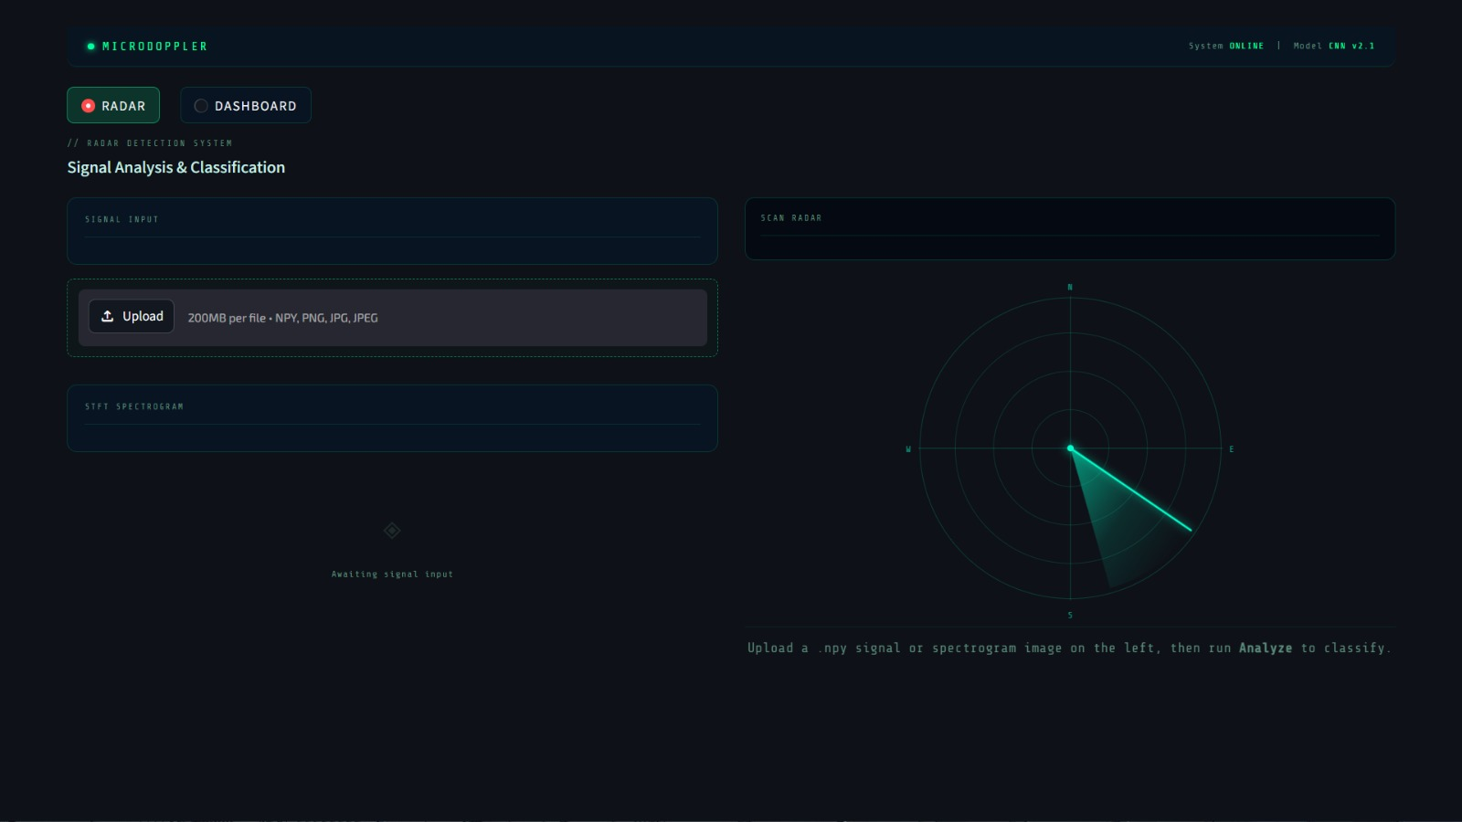
Snapshot of User Interface
Fig 9: User Interface Snapshot
5

Slide 13
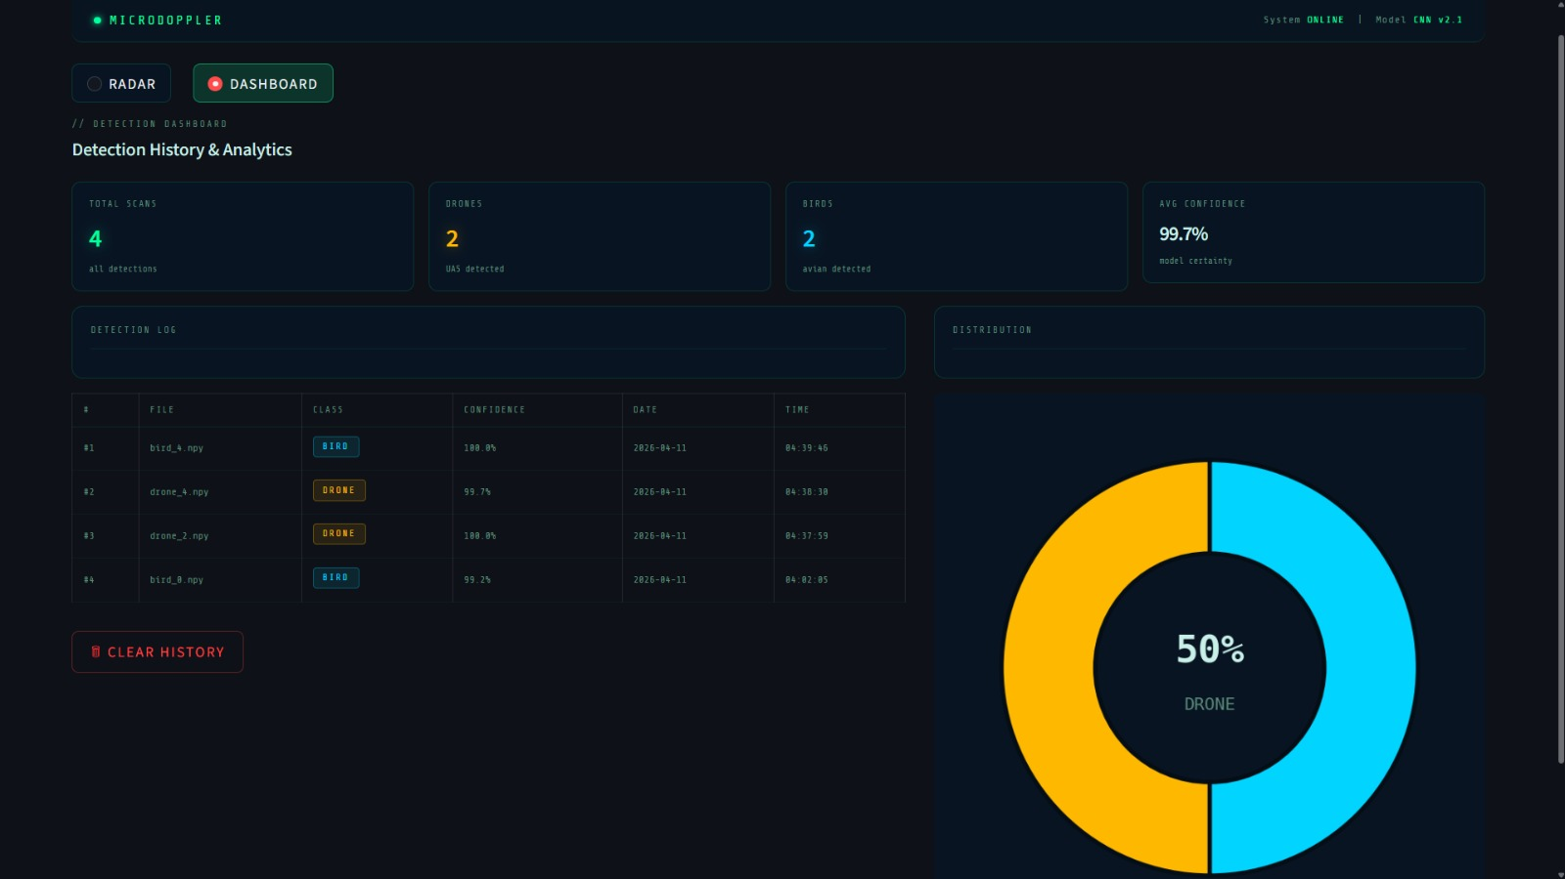
Snapshot of User Interface
Fig 10: User Interface Snapshot
5

Slide 14
Challenges and Future Work
CHALLENGES
Noise in Dataset
Data imbalance
Model overfitting
Signal variability
FUTURE SCOPE
Real-time deployment
Integration with IoT systems
Multi-object detection
Autonomous surveillance systems
5

Slide 15
Thank
You!
Sl. No: | Name | Course | College
1 | Kapil G Ratan | MCA – 2st Sem | RNSIT, Bangalore
2 | Tinku Jana | MCA – 2st Sem | RNSIT, Bangalore
6

